Slide 1
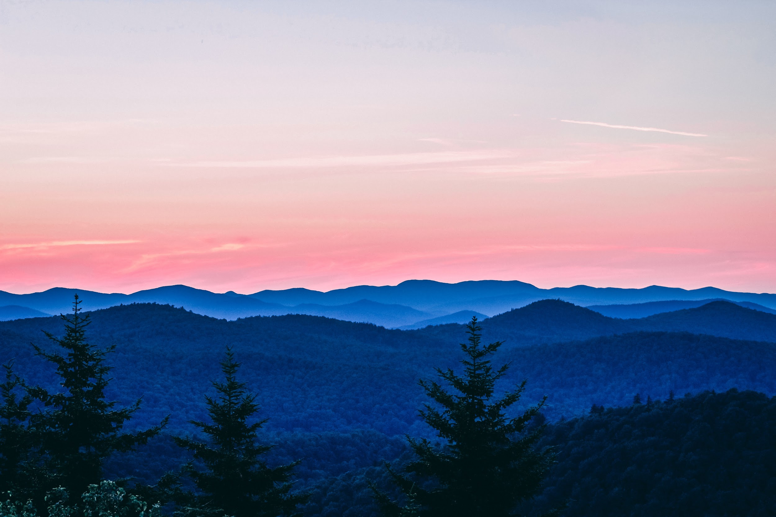
A rose by any other $variable
A paean to intentional language usage when discussing open source
Richard Littauer - http://richard.social SustainOSS - https://sustainoss.org
Photo by Patrick Bald on Unsplash

Slide 2

Who is this Richard Littauer, anyway
Linguist and Latin tutor
Developer
"Community manager"
Worked for: Hipcamp, MIT, Johns Hopkins, Protocol Labs, the OSI, Open Source Collective, the Digital Infrastructure Fund…
Currently: SustainOSS
Source not given

Slide 3
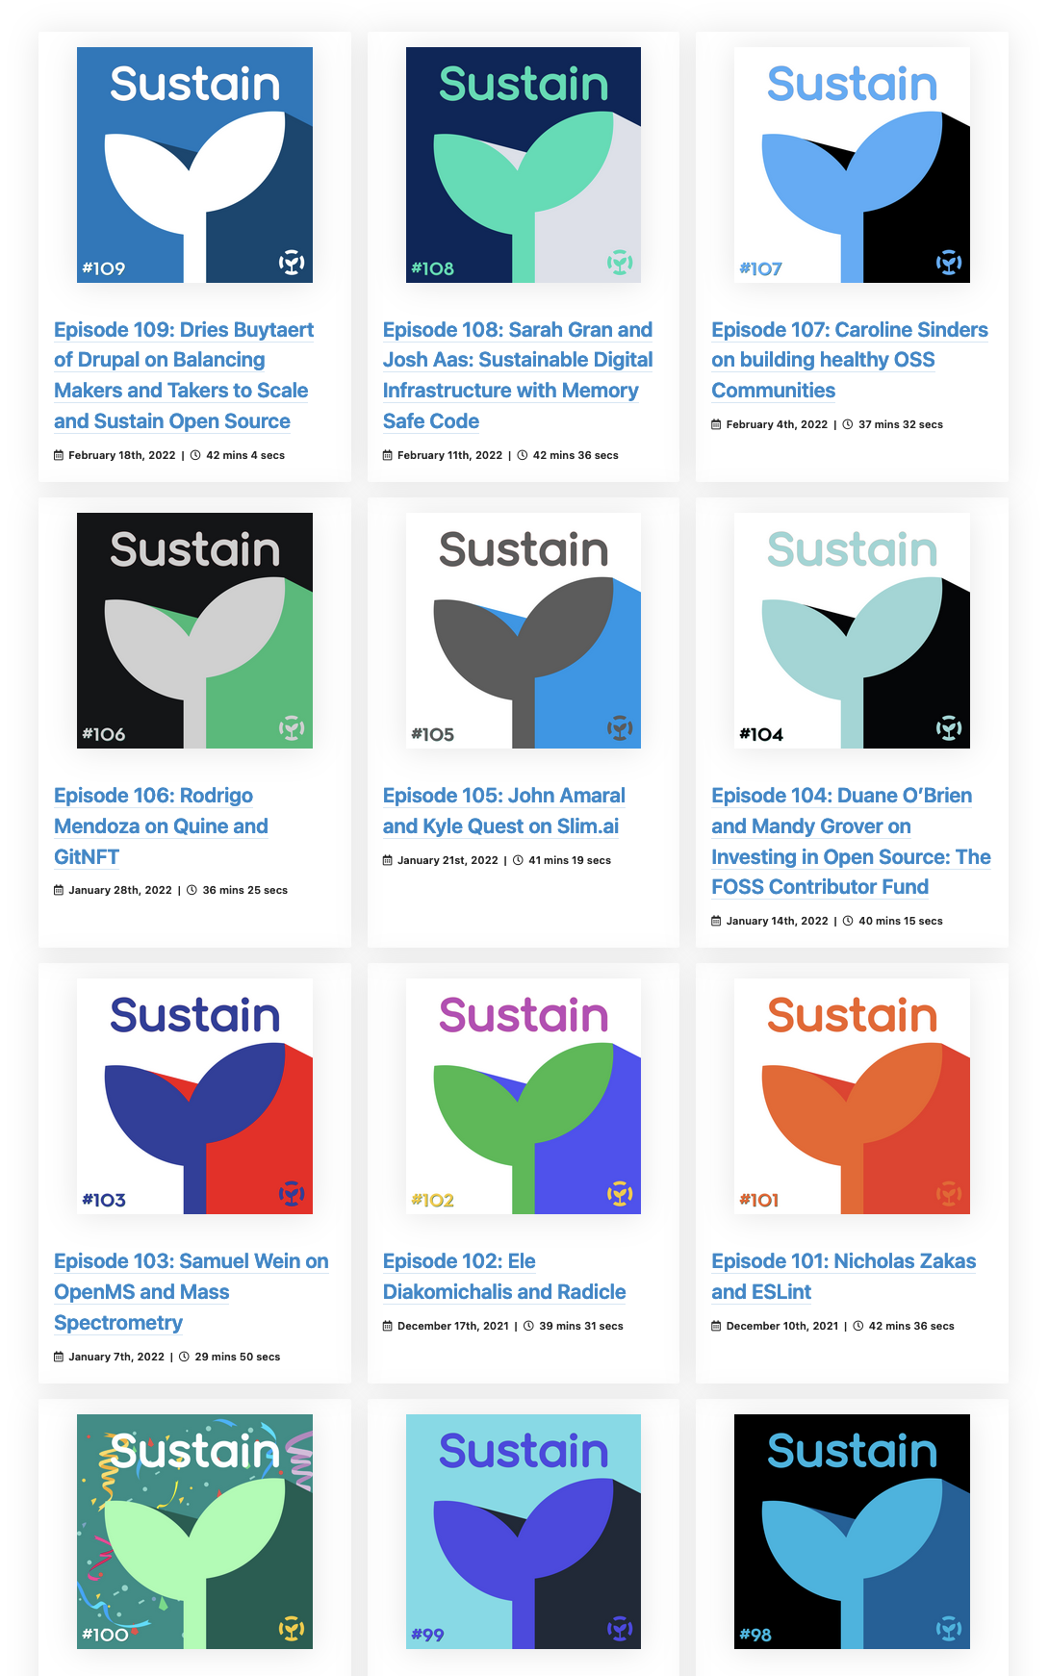
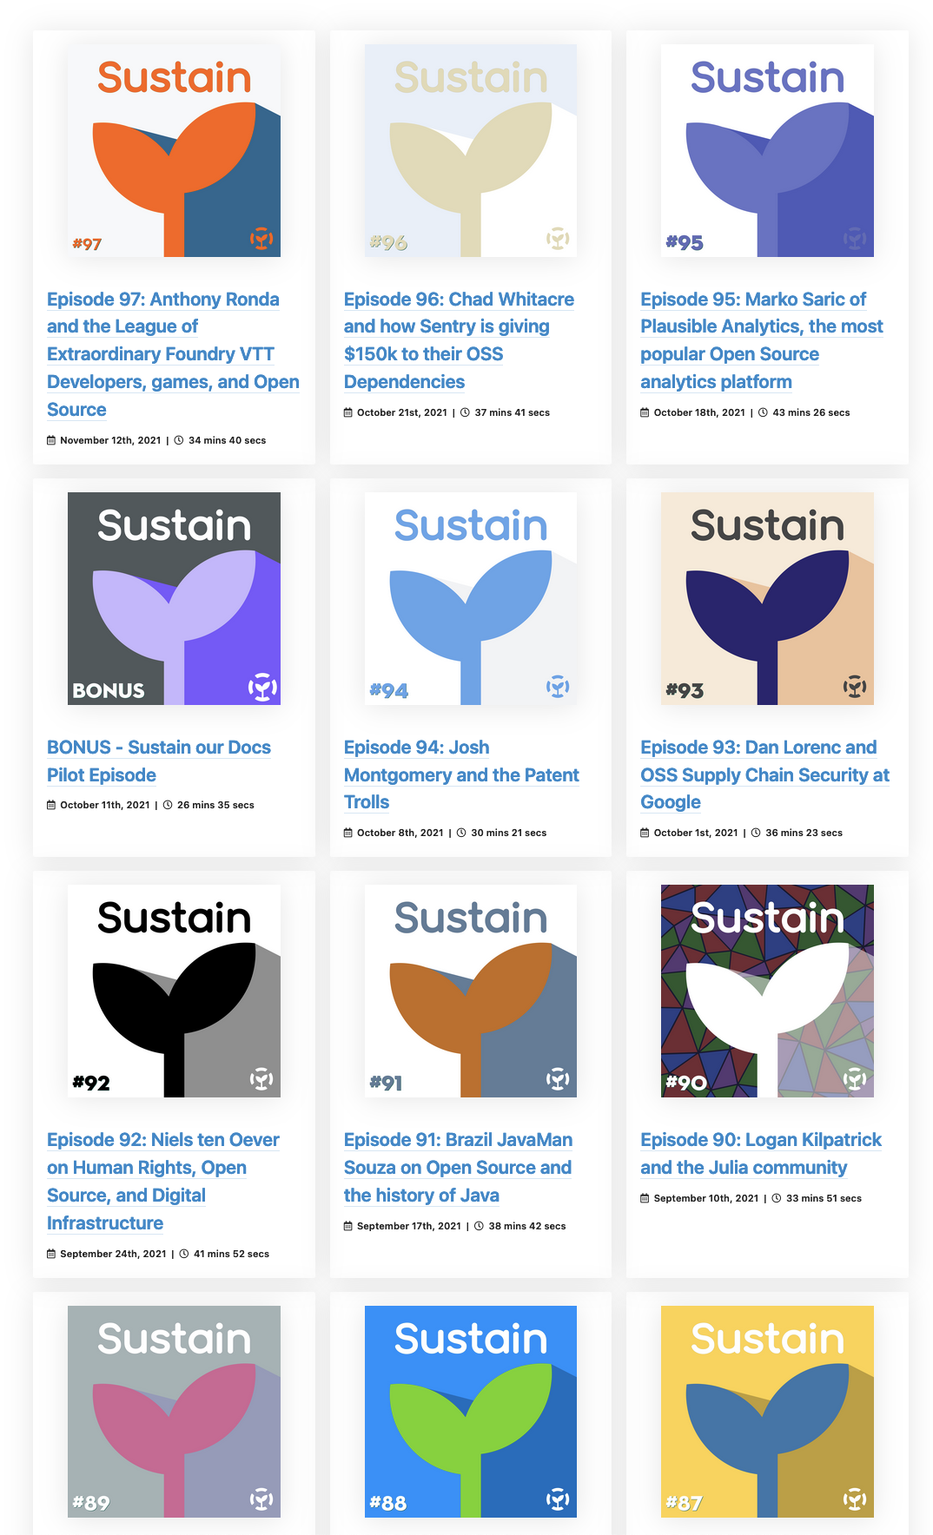
What is SustainOSS?
A community!
Conferences
Working groups
Academia, DEI, Design, and Governance
Podcasts

Slide 4
Where sustainability applies in FOSS:
Projects
Developers
Communities
Businesses
Academia
Ecosystems
Environment
Notes:
Let's go over these in depth, to see how it is applied.

Slide 5
Sustain: FOSS Projects
Growth
Diversity
Funding

Slide 6
Sustain: FOSS Projects
Growth
More in than out
Pathways to maintainer
Product management and design planning
Goal: capturing market share of attention

Slide 7
Sustain: FOSS Projects
Diversity
Welcoming community spaces
CoCs
Documentation
Moderation
Mentoring
Goal: towards some ethical destination

Slide 8
Sustain: FOSS Projects
Funding
Funding for the project costs
Funding for the core maintainers
Lifestyle funding
Funding for all contributors
Non-fiscal sponsorships

Slide 9
Sustain: FOSS Developers
Satisfaction
Career trajectories
Mentoring
Funds and recognition
Avoiding burnout

Slide 10
Sustain: FOSS Communities
Not always tied to a project
Functionally similar to what we talked about above
But at scale.

Slide 11
Sustain: FOSS Businesses and Corporate
Focus: a bottom line
Not pushing OSS onto your employee's private time
Having advocates and marketing inside the company for open source
OSPOs
"Collaboration"

Slide 12
Sustain: FOSS Academia
Not quite the same as industry or "open source"
Reproducibility
Citations and altmetrics
The project- or funding-based cycles of OSS in academia
The student-graduation cycle of academia
Where support comes from in the institution

Slide 13
Sustain: FOSS Ecosystem
Funding maintainers for their work
Security and supply chains
The "digital commons"

Slide 14
Sustain: FOSS Ecosystem
Legal sustainability and licenses
Stopping proliferation
Open washing
Patent issues
AI + open source
Taxation and infrastructural funding
The CRA and their ilk

Slide 15
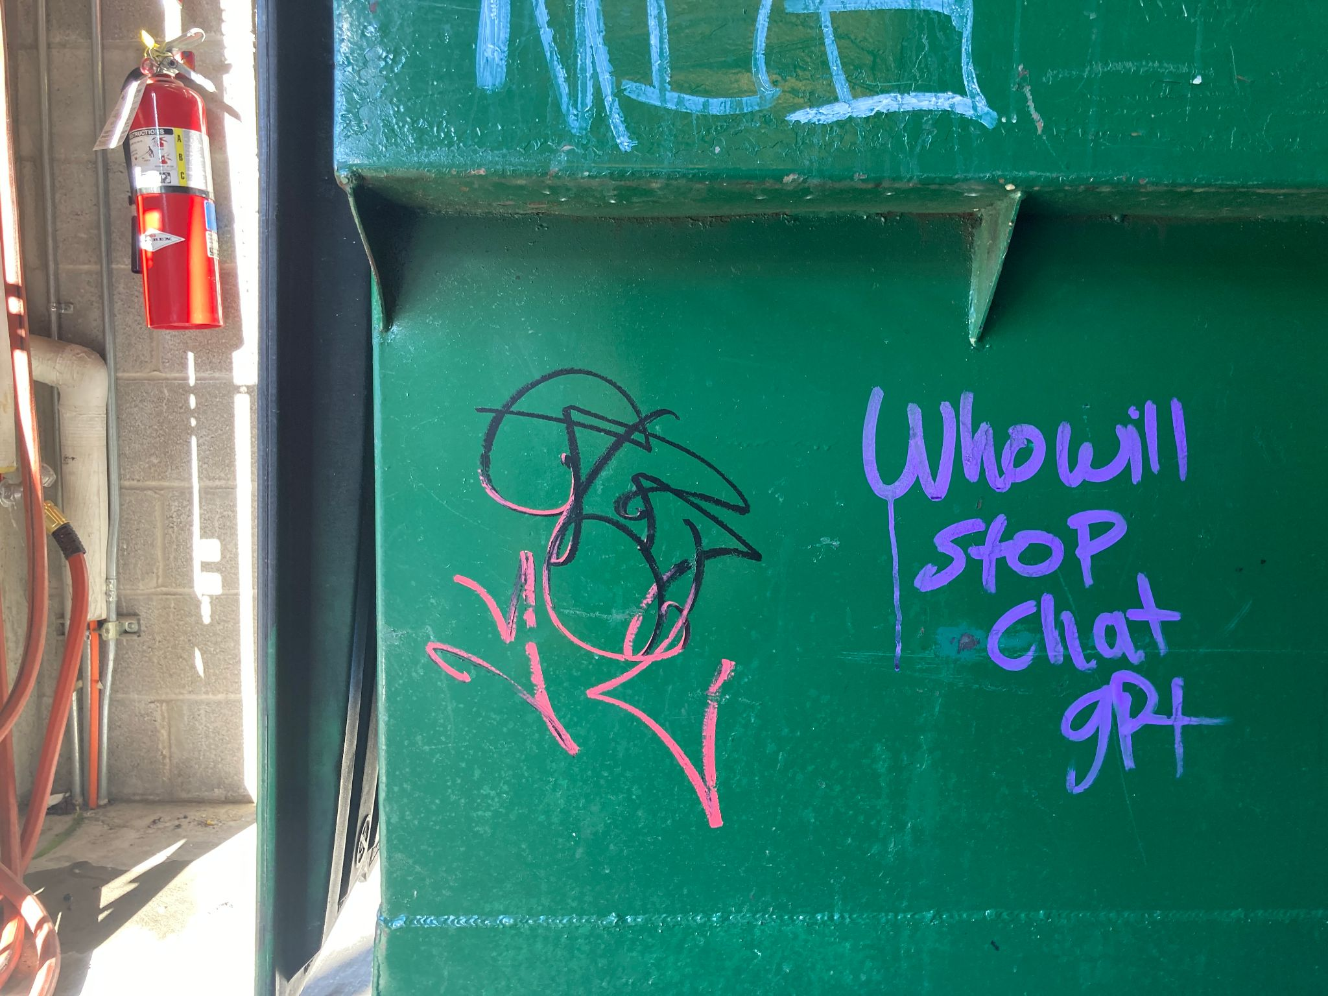
Sustain: FOSS Ecosystem

Slide 16
Sustain: FOSS & Environment
Open source hardware
Carbon-neutral data storage centers
Reducing server costs
Not using bitcoin
Avoiding the conference trap

Slide 17
Sustain: FOSS & the whole environment
Tech for environmental activists
Tech for environmental studies
Use of tech for the planet as a whole

Slide 18
Sustain???
At this point, it should be clear that "sustainability" is being overused and is somewhat semantically bleached.

Slide 19
When you see "Sustain", ask:
For what?
For whom?
For how long?
From what original state?
Why this term?

Slide 20
Sustain covers all manner of sins.
Was it healthy to begin with?
Were people treated well?
Were practices ethical?
What about all of the stuff we talked about above?

Slide 21
What does "sustain" mean, anyway?
Temporal term
It ignores:
End-of-life cycles for software projects
End-of-life cycles for software ecosystems
Boom-and-bust cycles for fads

Slide 22
"Sustain" fails to recognize:
Current achievements
Creative output
The bigger picture.

Slide 23

"Sustain"?
Leaky
Semantically bleached
Temporal
Source: Midjourney
Notes:
Leaky as in the ship of theseus - it doesn't really make a ton of assumptions about what is sustained

Slide 24
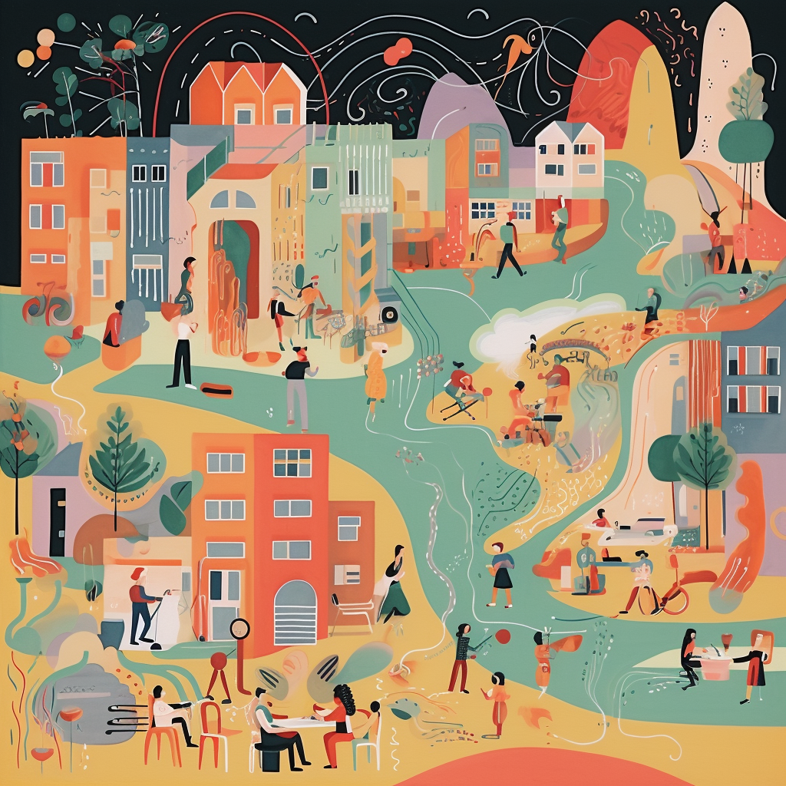
"But what practices make communities and workplaces open?"
Publishing the work in an accessible place.
Having a non-horrible governance pattern.
Building in successional power structures.
Source: Midjourney

Slide 25

Ok, but what practices?
Supporting more diverse communities.
Paying or otherwise remunerating maintainers.
Imparting a sense of meaning in the work.
Tracking impact for the work itself.
Source: Midjourney
Notes:
I don't know about open, but in terms of "better"...

Slide 26

But wait… what does open mean, here?
Source: Midjourney

Slide 27
Let's define it for open source:
License
or
Methods
Notes:
Functionally meaningful on two axes.

Slide 28

Let's define it for open source:
License
Methods

Slide 29
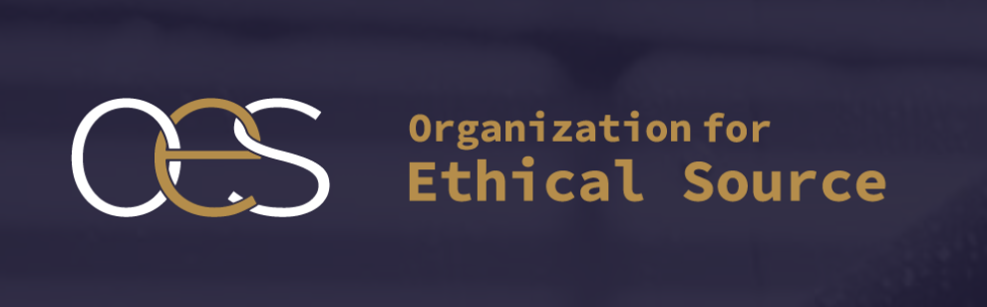
What about?

Slide 30

What about?
Open Source*
Source: Midjourney
Notes:
Among many other types of open, including RIT's Open Work

Slide 31
Using this definition:
Methods
"Open source is a verb, not a noun."
Notes:
Not entirely useful, because it obscures differences in action, but it's clear what it's saying - continued effort.

Slide 32

So what is open, then?
Antitrust maneuvering
Open washing
Avoiding sign-off from
bureaucrats.
Over-the-wall throwing
Source: Midjourney

Slide 33
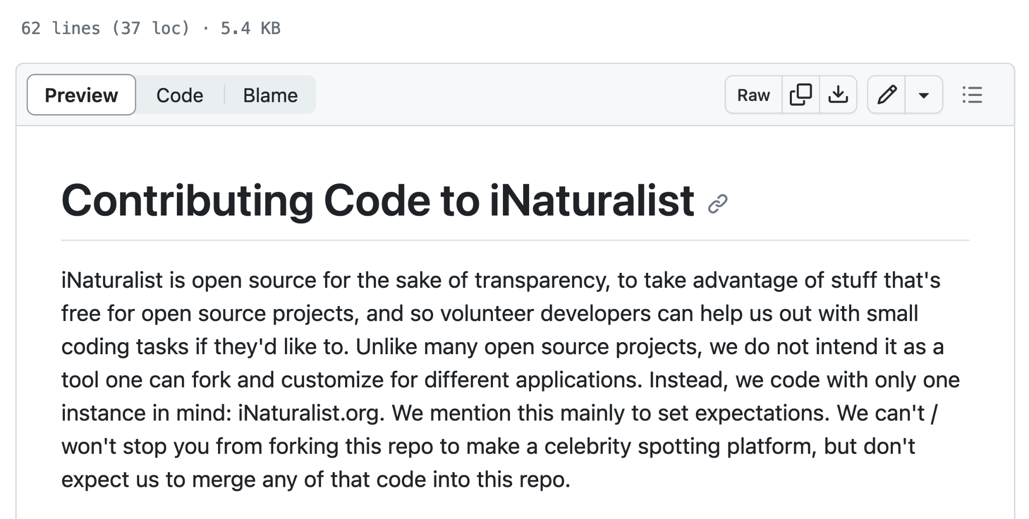
Nuance
https://github.com/inaturalist/inaturalist/blob/main/CONTRIBUTING.md

Slide 34
Nuance
Open source?
Yes. :|
https://github.com/inaturalist/inaturalist/blob/main/CONTRIBUTING.md

Slide 35
Conclusion
Not all open source communities are the same.

Slide 36
Conclusion
Not all open source is the same.

Slide 37
Conclusion
Not all open is the same.

Slide 38
But…
Is this project OSI approved: Yes or No.
Is it Open Source: Well…
Notes:
Why is one binary? Why isn't the other?

Slide 39
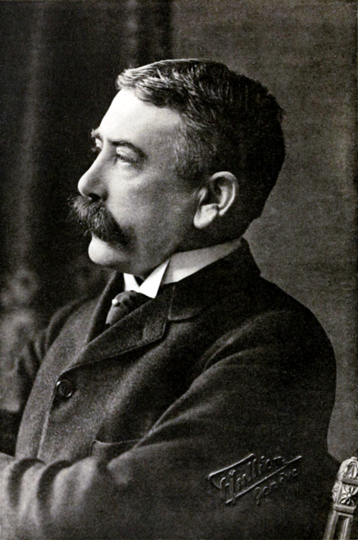
Because this guy
Ferdinand Saussure
Inventor of semiotics
Denotation
Connotation
Source: Wikipedia
Notes:
Denotation = the thing in the world. Connotation : all the stuff around it that we add.

Slide 40
Because this guy
Ferdinand Saussure
Inventor of semiotics
Denotation => OSI
Connotation => Open source more broadly
Source: Wikipedia

Slide 41
Abstractions
Depend upon shared context and delegated authority
Useful for talking to each each other

Slide 42
Abstractions
We lack this in open* outside of OSI-approved licenses.

Slide 43
A fix?
Define a taxonomy of all "open" terms, and identify core moral values that are contextually understood to be part of the process.
Community
Equality
Access for all
Etc…
Then, publish it.

Slide 44
A fix?
Funded by the US National Science Foundation, the Interdisciplinary Open Practices Workshop (the IOP Workshop) will establish an interdisciplinary understanding of what we know about open work practices (also called “open organizing”) and build collaborations to explore unanswered questions.

Slide 45
Let's go!
Open Science
Open Scholarship
Open Data
Open Education
Open Government
Open Strategy
Open Innovation
Open Platform
Open Access
Open Organizing
…

Slide 46
What about the unanswered questions?
How does an open source practitioners understanding of inclusion and proclivity for stability interact political inclinations towards hard-line OSD/OSI vs ethical source understandings of open source?
What makes a person more likely to work "in the open"? Is it because we're all morally good people, or we're more risk-prone, or what?
Can this be extended to other open practices?

Slide 47
Open source networks as complex systems with unique emergent patterns.
They're open systems that have an accelerated, non-random decay rates. How are project life-cycles related to ecosystem life cycles?
What are the bifurcation events for critical transitions? License changes (à la Hashicorp)? Societal changes (kicking Stallman out of the room)? Hard forks (Ethereum)? How do these affect changes differently?
What are the topologies of language ecosystems? How can we model their death and growth, and can we predict them - and if we can, how can we invest in ecosystems better?

Slide 48
Economics models?
Is there an Economic Complexity Index for language ecosystems related to uses of a given language - aka, does isomorphic code explain JavaScript and Python's prevalence over, say, Perl and R
How do societal changes to software packages - the Node/IO fork - compare to laminar and turbulent phases of an economy?
Can you use Git to track this?

Slide 49
Not all dependencies are equal
How do you evaluate the importance of popular utility libraries versus niche heavy lifting libraries?
How do you control for their inherent charisma or salience to the developers who use them?

Slide 50

Out there…
How many open source authors ride bikes?
Or… how many view the commons as a collective investment versus an extractive resource?
Source: Midjourney

Slide 51
Finally…
Most research software is discovered in an ad hoc approach, as social norms and cognitive storage limits preclude citing entire dependency trees as research objects.
How do we get around this?
Also: Thank you.
Richard Littauer – podcast.sustainoss.org – richard.social

